Slide 1

InnoVision Think is the new era
Prathamesh Shambhuche
EMS

Slide 2
Agenda
Introduction
Literature Survey
Software Requirement Specifications
Analysis and Detailed Designs
Implementation
Testing
Conclusion
Future Enhancements

Slide 3
INTRODUCTION
The EMS (Event Management System) is a straight forward idea of helping the management and organizers of a respective college in conducting an event in a systematic approach.
This system helps in processing all the background works that go in an event, right from the declaration of events to the rounds and calculating the scores.
The system takes car about the levels of users and with the access given to them they can carry out their activities and update the system with the new data with the timeline.
It stores all the data in centralized database which can be further used in analysing the future events and to make it better than the conducted one.
It dynamically creates the Registration form for participants whose data is again stored into the databases.

Slide 4
LITERATURE SURVEY
Existing System
All the events are manually managed.
Every event will have a website and an optional mobile application to provide information and registration.
All the backend works are carried out manually by the organizing teams.
All the event heads and volunteers should be notified manually about the details of the events and rounds.
Proposed System.
Event management system provides a software solution to the organizers so that they can centralize all their work at a single place and manage it better and these details can be referenced in future.
Event management system stores registration details of the students, college details. This application also stores the details about the rounds like round name, place and judges, start and end time of round etc. This details can be used to get the status of rounds of all events at a particular instance.

Slide 5
SRS
Users
Administrator
Event Heads
Photographers.
Registration Team.
Hardware Requirements
Processor: Dual core or above
Ram: 1 GB
Hard Disk Drive: 160 GB
Software Requirements
Web browser for application
Server space.
Technologies and Tools used for Development
Languages: HTML, CSS, PHP, Java Script, Jquery, Code Igniter Framework, Bootstrap Framework.
Database: MySQL.
Tools: XAMPP server, Adobe Dreamweaver

Slide 6
Functional Requirement
Monitoring rounds, place of event.
Monitoring and resolving time and place clashes.
Centralized tracking of events.
Updating score sheets after every round.
Adding and viewing photos.
Adding and evaluating score sheets.
Tracking start and end of events.
Non-Functional Requirements
Speed
Size
Ease of use
Reliability
Portability

Slide 7
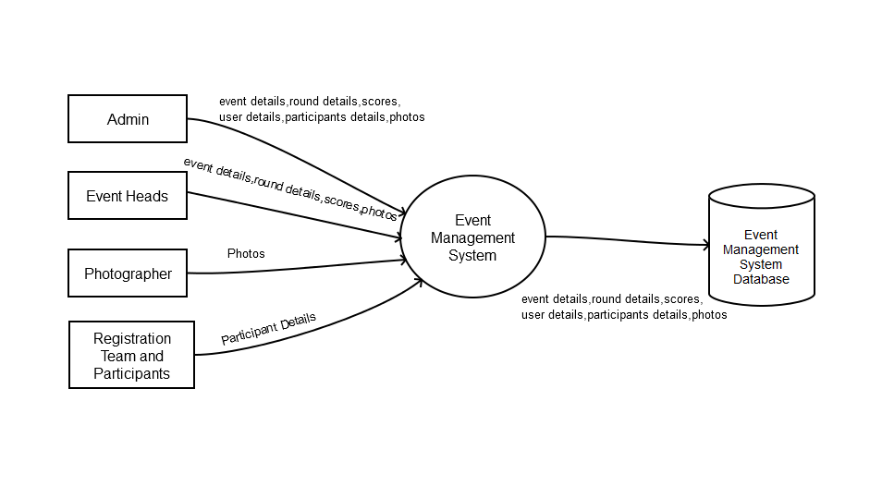
Analysis and Detailed Designs
Context level DFD

Slide 8
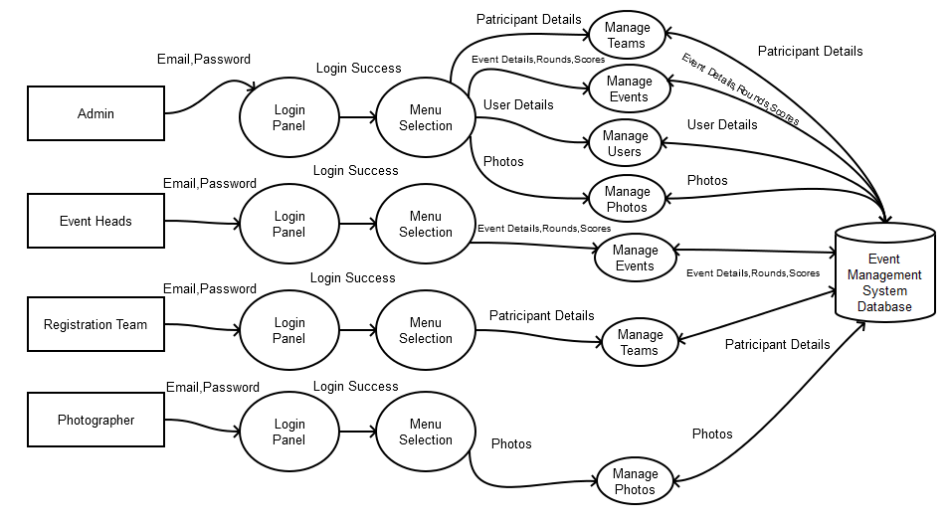
Level One DFD

Slide 9
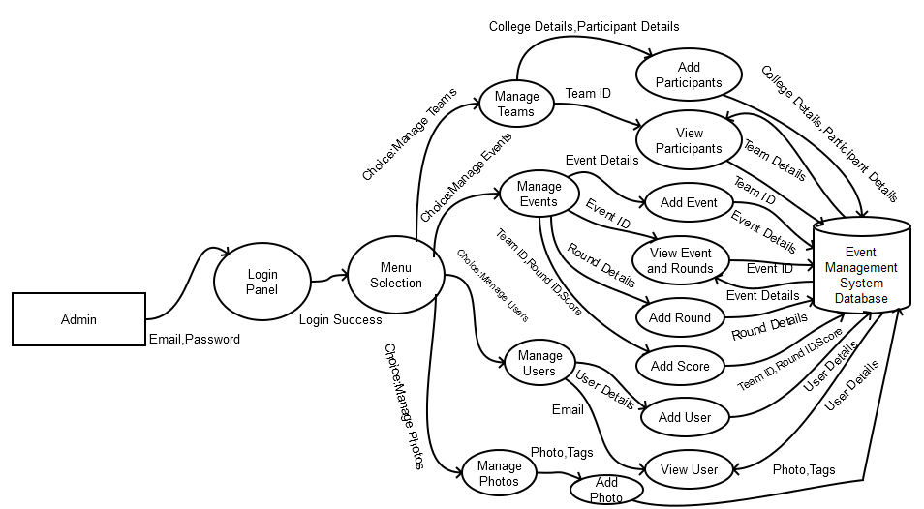
Detailed DFD

Slide 10
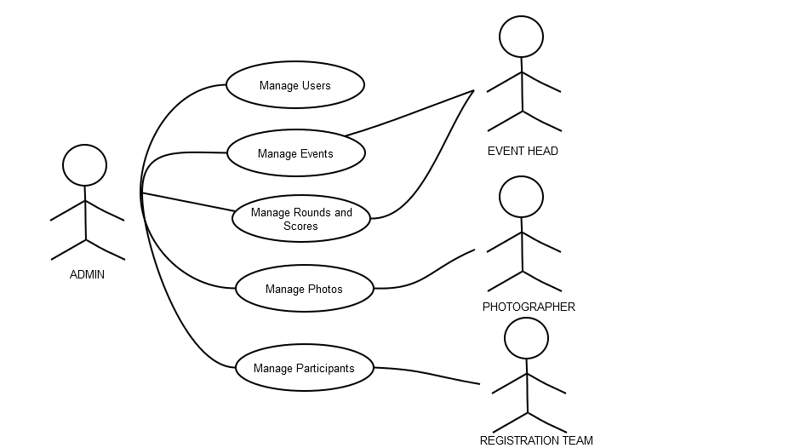
USE CASE FOR EMS

Slide 11
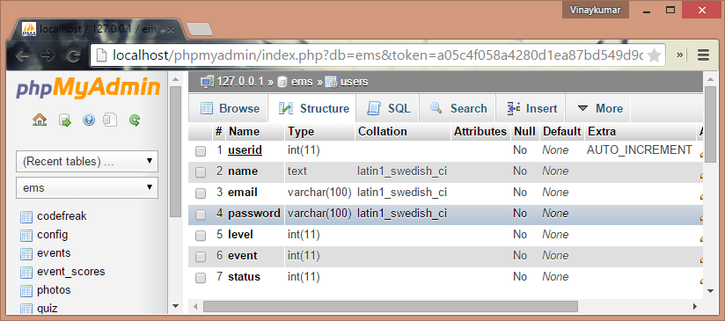
DATA BASE DESIGN

Slide 12
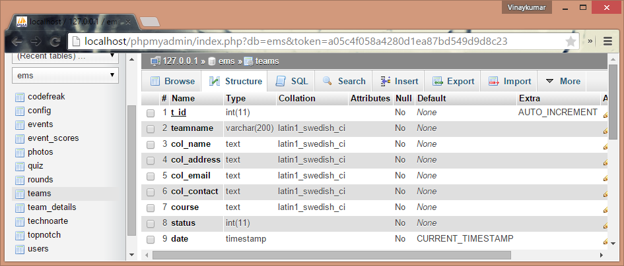

Slide 13
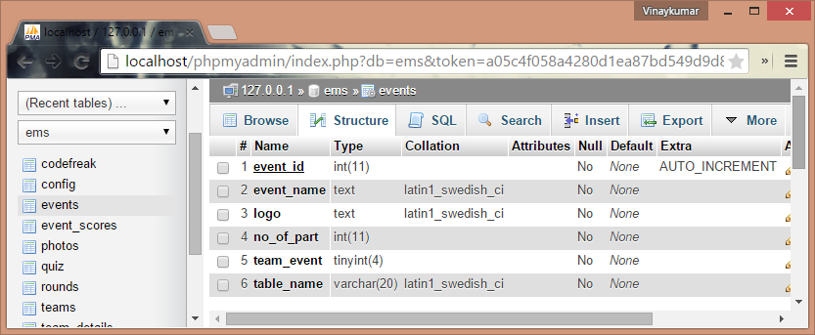

Slide 14
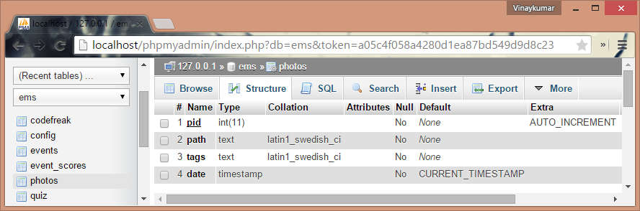

Slide 15
IMPLEMENTATION
.

Slide 16
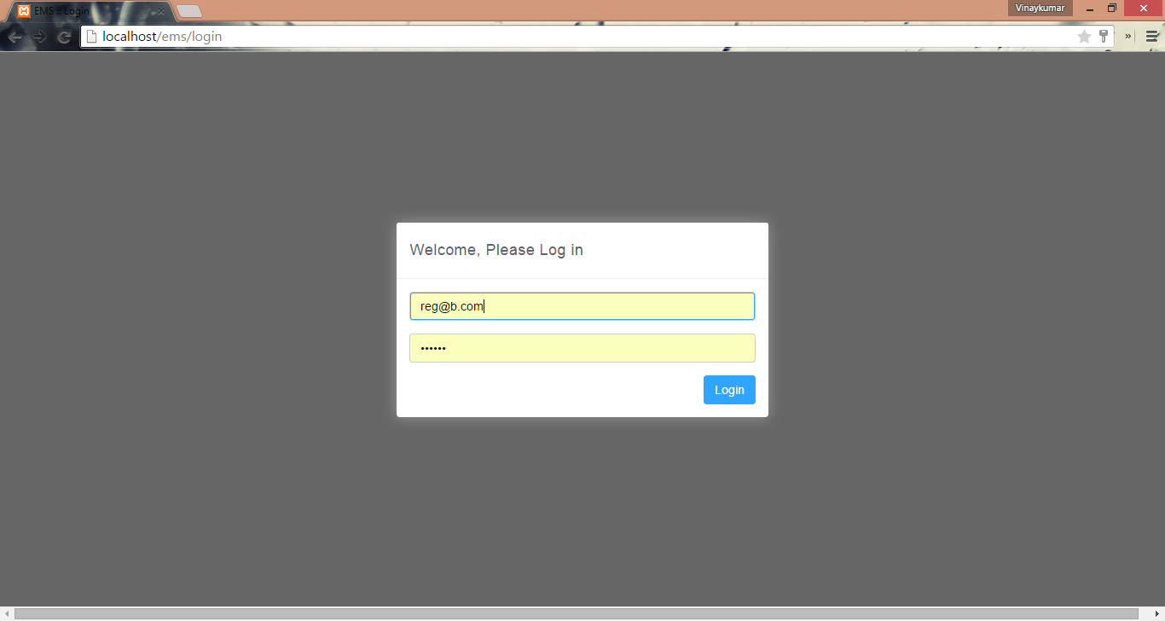
SCREEN SHOTS

Slide 17
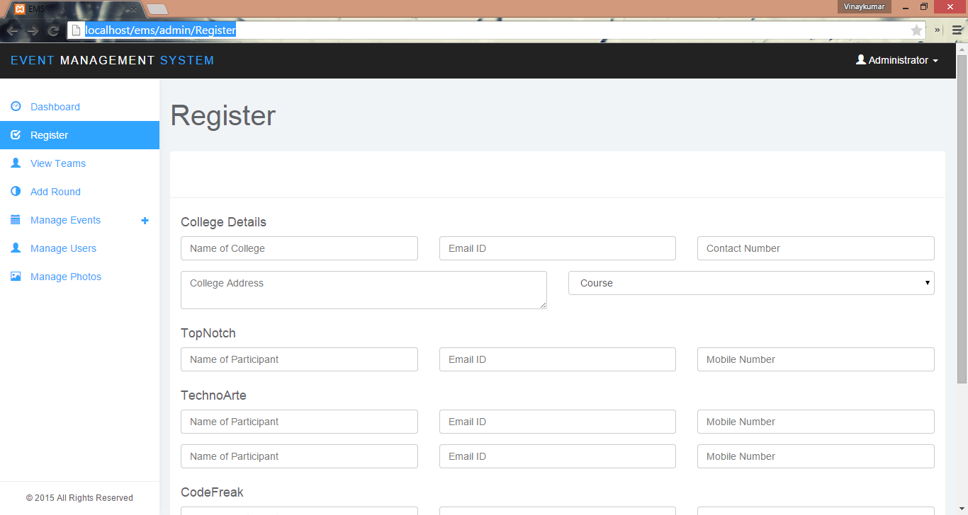

Slide 18
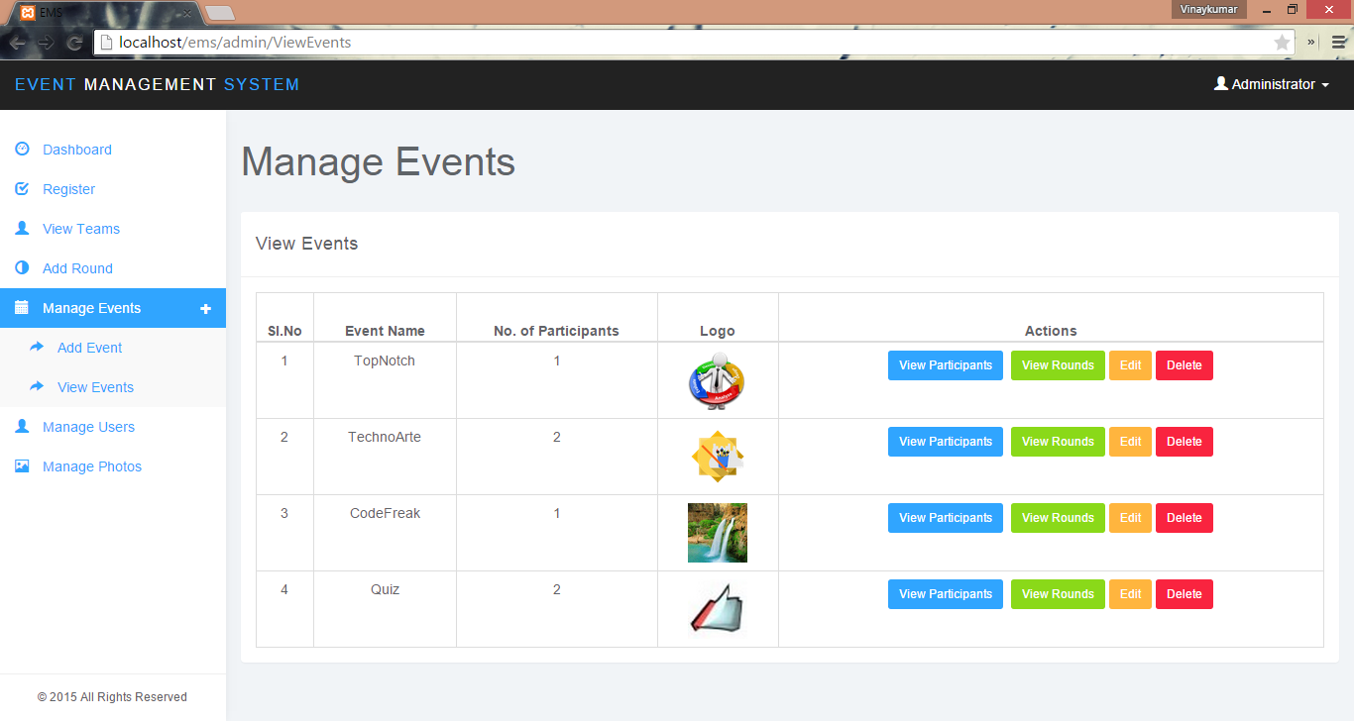

Slide 19
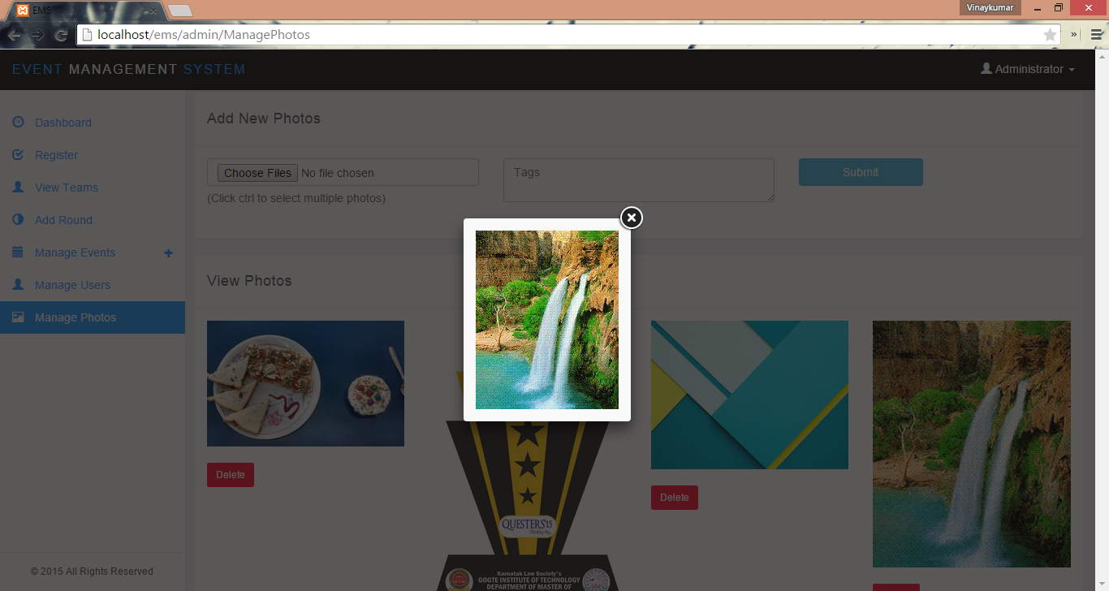

Slide 20
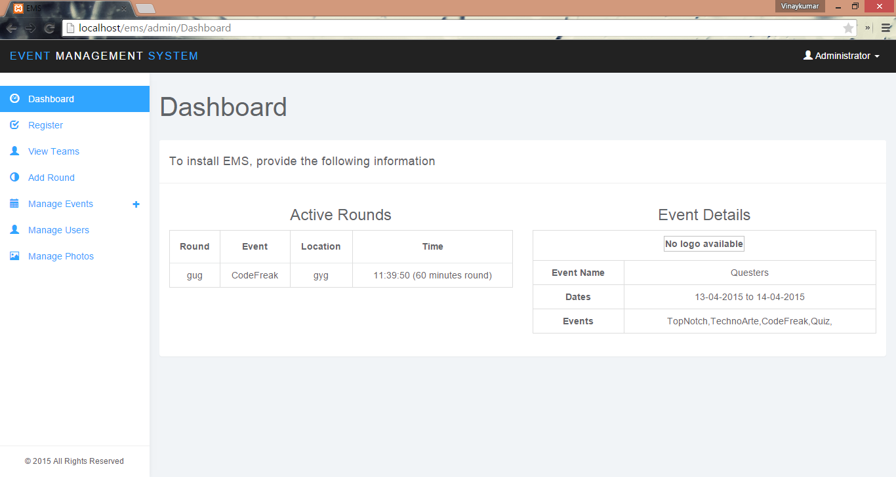

Slide 21
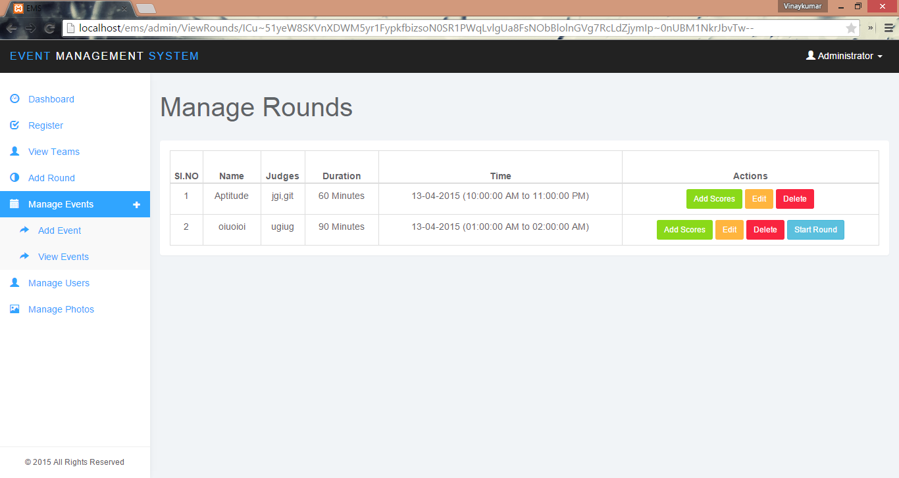

Slide 22
TESTING
TESTED MODULES
Login.
Registration.
Score Sheets.
Photos.

Slide 23
COCNCLUSION
The Event Management System will provide a complete solution for the events held at the colleges. It will assist organizers to manage the entire event in centralized manner. With various services to monitor and resolve time and place conflicts. Along with storing centralized data of the participants, from their registration to their score cards for every round.

Slide 24
FUTURE ENHANCEMENT
Pre-built website for the event.
Support for video and audio uploads.
Integration of mobile application.
Social media integration.

Slide 25
Thank you
Its not about reaching your potential,
its all about exceeding it

